Slide 1
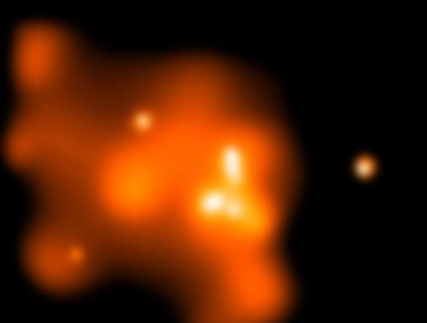
Numerical Simulation of Black Hole Accretion and outflow
Feng Yuan
中科院上海天文台
June 2, 2016; KIAA-PKU

Slide 2
OUTLINE
General introduction to BH accretion
Accretion:
Hot accretion flow: wind
Slim disk: radiation
Jet formation:
BZ jet
Disk jet
Observational tests
All are attributed to rapid development of numerical simulations in recent years.

Slide 3
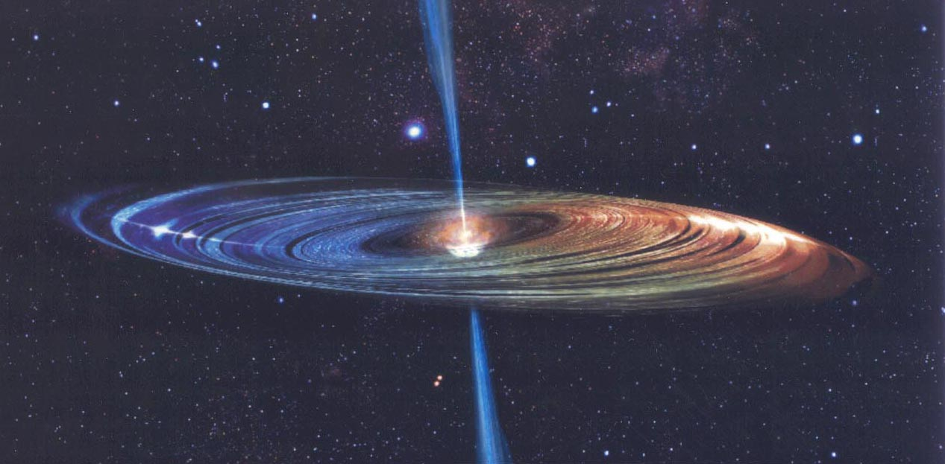
Black Hole Accretion Disks
Many kinds of accreting BHs in the universe
Active galactic nuclei: AGN
X-ray binaries: XRB
Gamma-ray bursts: GRB
Tidal disruption events: TDE
Surprisingly diverse phenomena
Huge amount of data: spectra, variability…
Relativistic jets
Energy/mmtm feedback from AGN: M_{BH}-σ_{bulge}
There are different accretion regimes

Slide 4
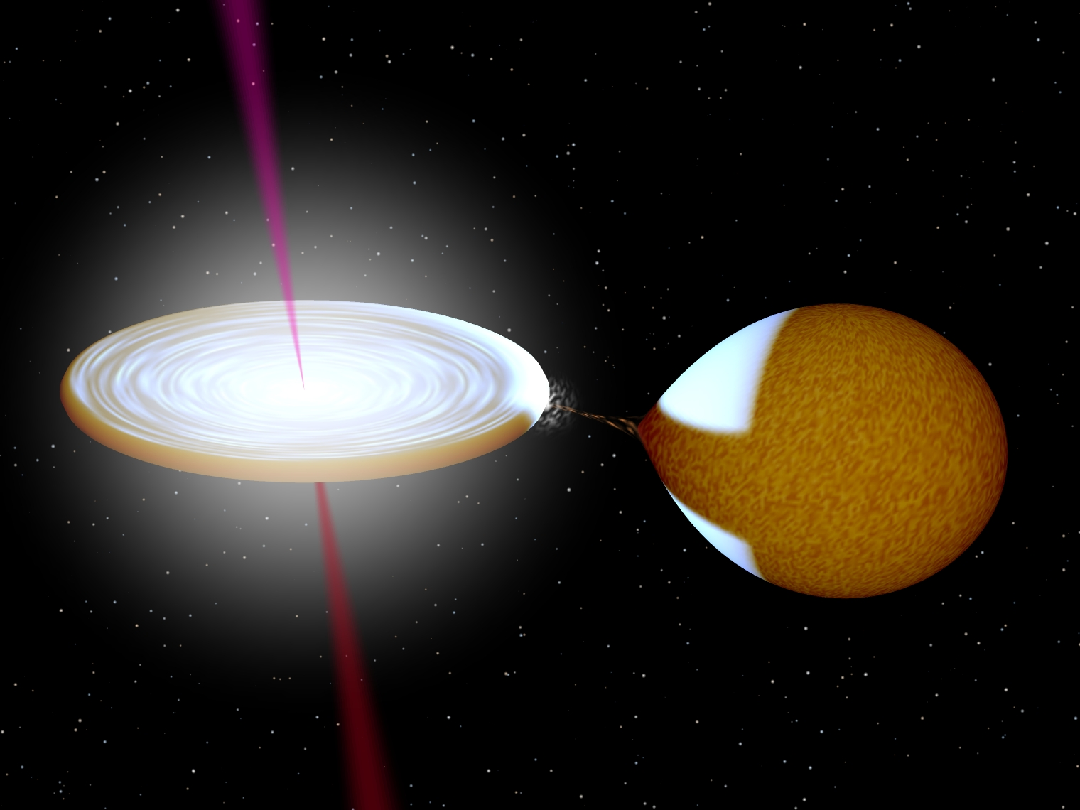
AGN Image credit: M. Inoue
XRB Image credit: Robert Hynes

Slide 5
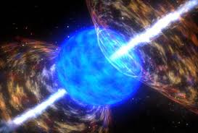

GRB
TDE

Slide 6
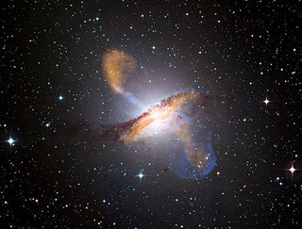
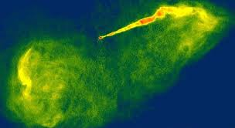
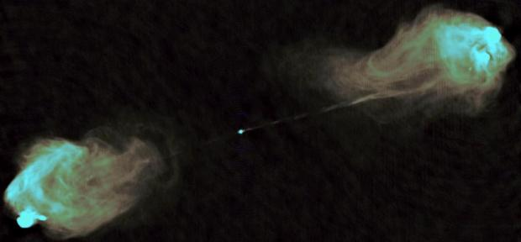
Relativistic Jets
Centaurus A
Virgo A
Cygnus A

Slide 7
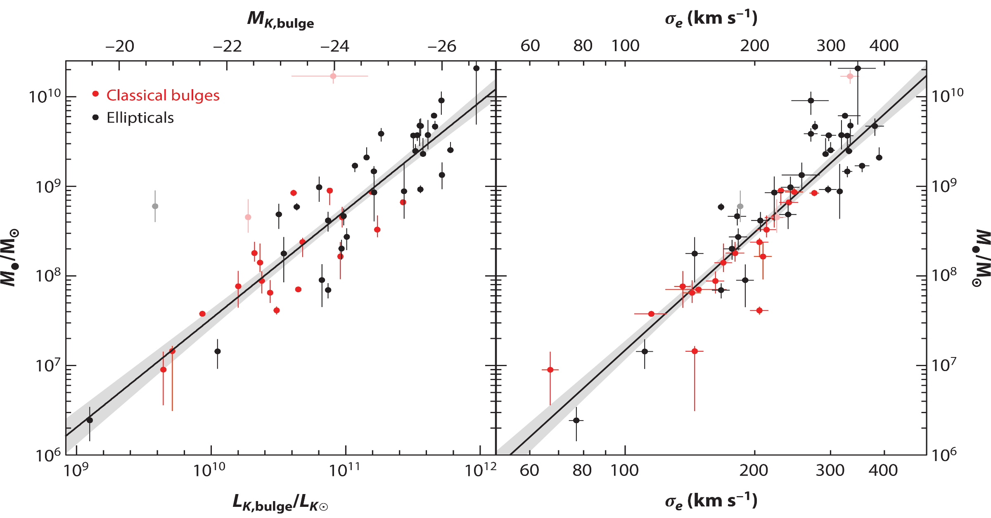
The BH-Bulge Relation
There is a remarkable correlation between the mass M of the central supermassive black hole and the luminosity L of the host galaxy
Important clue on the formation/evolution of SMBHs and galaxies
Kormendy & Ho (2013)
Gultekin et al. (2009)

Slide 8
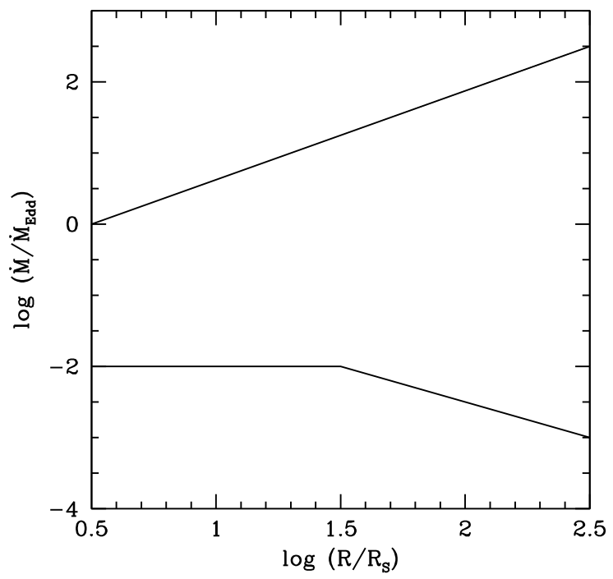
Accretion Regimes
Hyper-accretion, slim disk, ADAF (Abramowicz et al. 1989; N & Yi 94)
Super-Eddington accretion
TDEs, ULXs, SS433
Thin accretion disk: radiatively efficient (Shakura-Sunyaev, Novikov-Thorne 73)
Typical QSOs, Seyferts
XRBs in thermal soft state
Hot Accretion, ADAF, radiatively inefficient (Narayan & Yi 94, 95; Abramowicz et al. 95; Yuan & N 2014)
LLAGN, BL Lac objects, Sgr A*, M87
XRBs in hard state, quiescent state

Slide 9
Analytical Disk Models
Useful 1D models have been derived for all three regimes by simplifying the equations and integrating vertically
These solutions provide a lot of insight
However, vertically integrated 1D models cannot describe jets and winds
These phenomena are inherently 2D
Need numerical simulations

Slide 10
Numerical Simulations
Numerical simulations can include all the complex physics that purely analytical methods cannot handle
Magnetic fields (MRI – “viscosity”) ➔ MHD
Multi-dimensional ➔ 3D MHD (for MRI)
General relativity (BH) ➔ 3D GRMHD
Radiation ➔ 3D GRRMHD

Slide 11
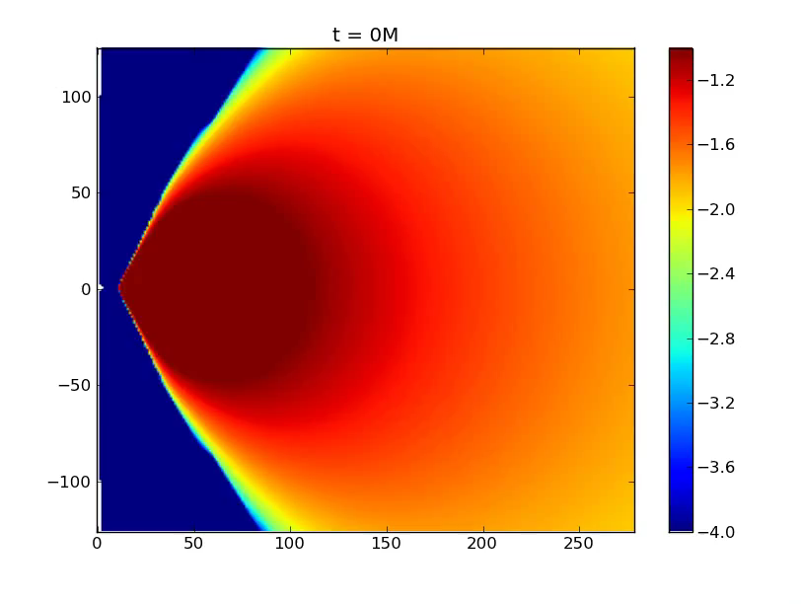
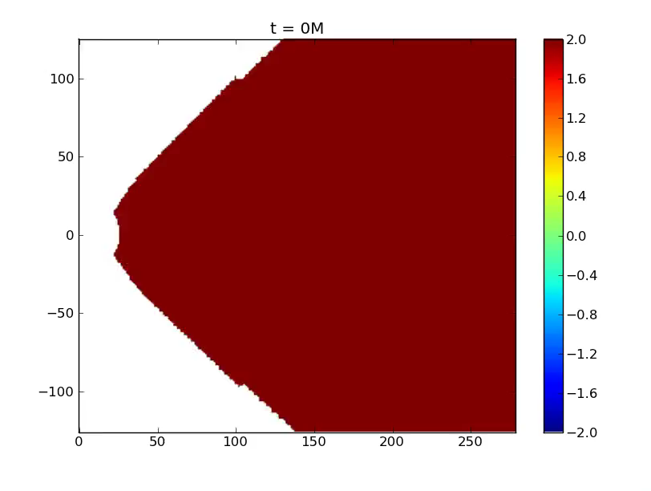
A very long time scale GRMHD simulation of hot accretion on a non-spinning BH
(Narayan et al. 2012)
t_{max} = 200,000 GM/c³
Log (density)
Log (P_{gas} / P_{mag})

Slide 12
Brief History of Simulations
Hydrodynamics (HD): early years
Local MHD “shearing box” (Hawley & Balbus 1991; Gammie, Stone: 1990s)
Global MHD full disk models (Stone, Igumenshchev, Hawley: ~2000)
RHD & GRMHD (Ohsuga, Koide, Gammie, McKinney, Hawley, de Villiers: early 2000s)
Global radiation MHD (Ohsuga 2000s)
GRRMHD (Sadowski, McKinney: 2014)

Slide 13

Magneto_Rotational Instability (MRI)
MRI: Differentially-rotating flow with a weak vertical magnetic field is linearly unstable
(Balbus & Hawley 1991)
Clearly seen in local MHD simulations in a “shearing sheet”
Non-linear development of the MRI gives MHD turbulence, which transports angular mmtm (disk “viscosity”)
φ
R
Movie courtesy: Charles Gammie

Slide 14
Topic 1: Wind from hot accretion flows

Slide 15
(MHD) wind from hot accretion flow: overview
Narayan & Yi (1994), Blandford & Begelman (1999) speculate there should be outflow
Be>0; but…
HD & MHD simulations of Yuan, Bu & Wu (2012):
Self-consistently simulate both disk and outflow
show the existence of MHD outflow
Study properties of outflow
Analytical works:
1D: Begelman (2012); Gu (2015)
2D: Jiao & Wu (2011); Mosallanezhad, Bu & Yuan (2016)

Slide 16
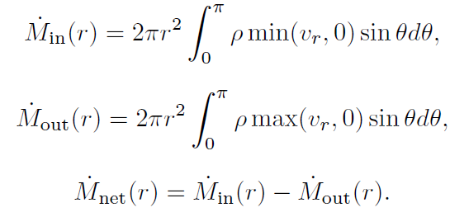
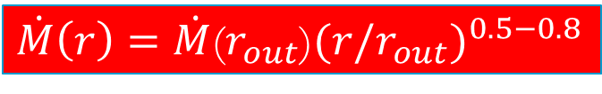
Accretion rate decreases inward
Stone, Pringle & Begelman 1999; Stone & Pringle 2001; Hawley & Balbus 2002; Machida et al 2003; Pen et al. 2003; Igumenshchev, Narayan & Abramowicz 2003; Pang et al. 2010; Yuan & Bu 2010; Yuan, Wu & Bu 2012; Li, Ostriker & Sunyaev 2013
Inflow rate
Outflow rate
Net rate
$\dot{M}\left(r\right)=\dot{M}$($r_{out}$)${(r/r_{out})}^{0.5−0.8}$
Stone, Pringle & Begelman 1999

Slide 17
Confirmed by Observations of Sgr A*
Aitken et al. 2001; Bower et al. 2003, 2005; Yuan, Quataert & Narayan 2003
Chandra observations + Bondi theory give the Bondi rate:
(consistent with numerical simulation of Cuadra et al. 2006)
High linear polarization at radio waveband requires innermost region accretion rate (rotation measure requirement):
So Mdot must decrease inward

Slide 18
Two Models proposed to explain the simulation
ADIOS (Blandford & Begelman 1999; 2004)
Assumption: Mass loss in outflow → Mdot decreases
CDAF (Narayan et al. 2000; Quataert & Gruzinov 2000)
basis: accretion flow is convectively unstable
MHD flow is convectively unstable?
Which one is correct? Debated for more than 10 years
Wind exists or not? this is important since:
Wind: a fundamental question
Important medium for AGN feedback

Slide 19
Which one is correct, ADIOS or CDAF? Yuan et al. (2012, 2015)
Performed HD & MHD simulations
Theoretical analysis:
If convective turbulence, we expect: inflow & outflow properties roughly same; → different!
Analyze the convective stability of MHD accretion flow → stable!
Conclusion: strong outflow exists
Different from Narayan et al. (2012); why?

Slide 20
Outflow confirmed by new observations
Wang et al. 2013, Science
3Ms observation to the quiescent state of Sgr A* by Chandra
H-like Fe Kα line profile fitting
→ flat density profile
→ outflow

Slide 21
“Virtual particle trajectory”
Yuan et al. 2015
Trajectory approach
different from streamline;
Based on 3D GRMHD data
Firstly used in BH accretion
Disk-jet
BZ jet
wind
3D
2D

Slide 22
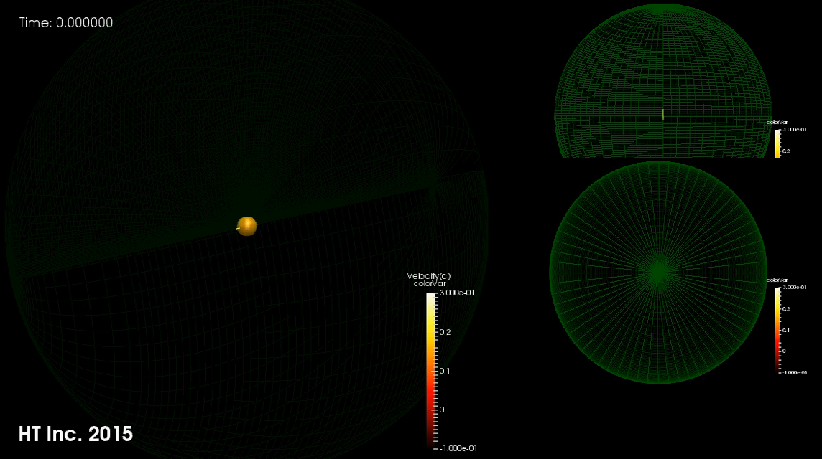

Slide 23



Properties of wind: mass flux
Yuan et al. 2015; Yuan et al. in preparation
“Normal” magnetic field:
${\dot{M}}_{wind}$=${\dot{M}}_{BH}\left(r\right)\left(\frac{r}{20r_{s}}\right), a=0$
${\dot{M}}_{wind}$=${\dot{M}}_{BH}\left(r\right)\left(\frac{r}{10r_{s}}\right), a=0.9$
“Strong” magnetic field (MAD):
${\dot{M}}_{wind}$=${\dot{M}}_{BH}\left(r\right)\left(\frac{r}{5r_{s}}\right), a=0.9$

Slide 24
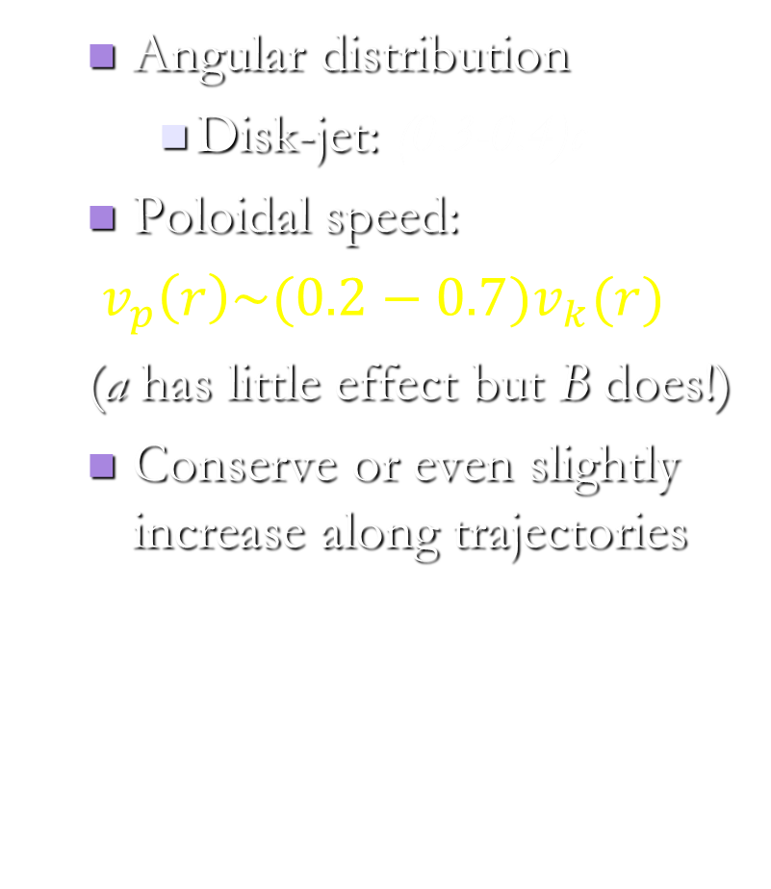
Properties of wind: poloidal speed
Yuan et al. 2015; 2016
Angular distribution
Disk-jet: (0.3-0.4)c
Poloidal speed:
$v_{p}\left(r\right)\sim (0.2−{0.7)v}_{k}(r)$
(a has little effect but B does!)
Conserve or even slightly increase along trajectories

Slide 25
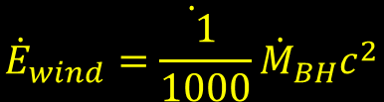
Properties of outflow: energy flux
Yuan et al. 2015; 2016
Contribution from: plasma & Poynting flux
Energy flux (MAD & a=0.9)
For MAD & a=0.9:
wind < jet (for both plasma & Poynting flux)
Disk-jet > BZ jet
For all other cases (SANE & any a):
wind > jet
Disk-jet > BZ jet
Energy flux of wind vs. accretion:
$$\dot{{\dot{E}}_{wind}=\frac{1}{1000}{\dot{M}}_{BH}c^{2}}$$
→ consistent with AGN feedback simulations

Slide 26
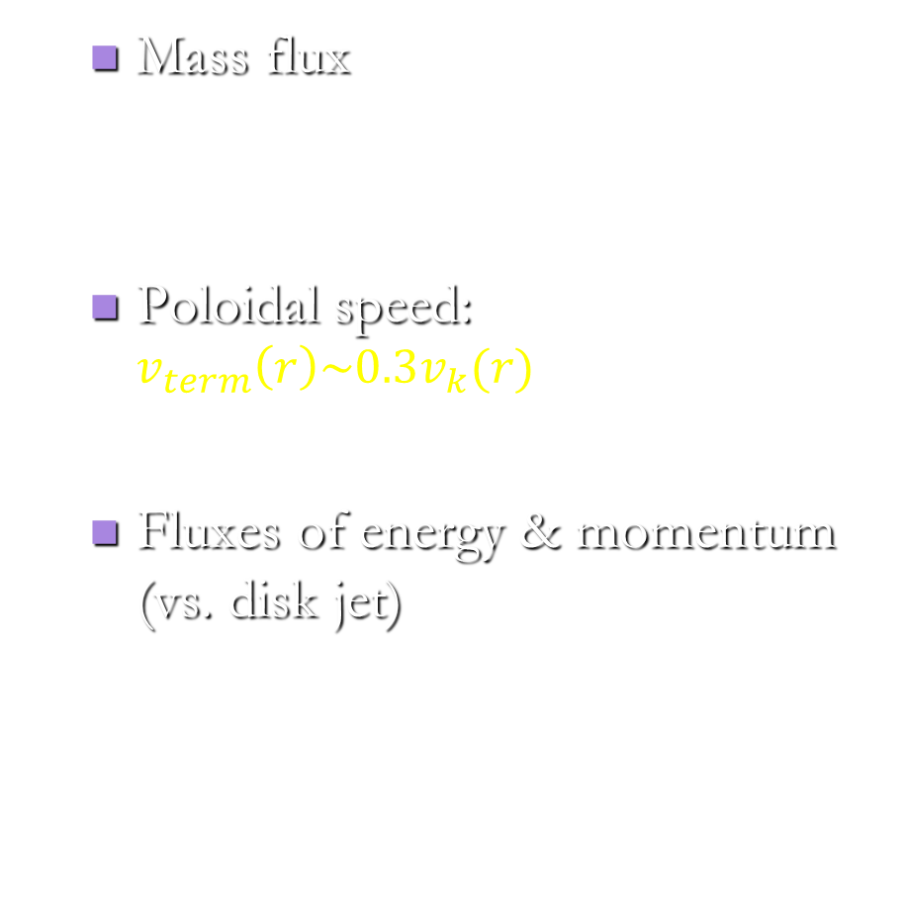


Main properties of wind
Yuan et al. 2015
Mass flux
Poloidal speed: $v_{term}\left(r\right)\sim 0.3v_{k}(r)$
Fluxes of energy & momentum (vs. disk jet)
${\dot{M}}_{wind}$=${\dot{M}}_{BH}\left(r\right)\left(\frac{r}{20r_{s}}\right), a=0$
$$\dot{{\dot{E}}_{wind}=\frac{1}{1000}{\dot{M}}_{BH}c^{2}}$$

Slide 27
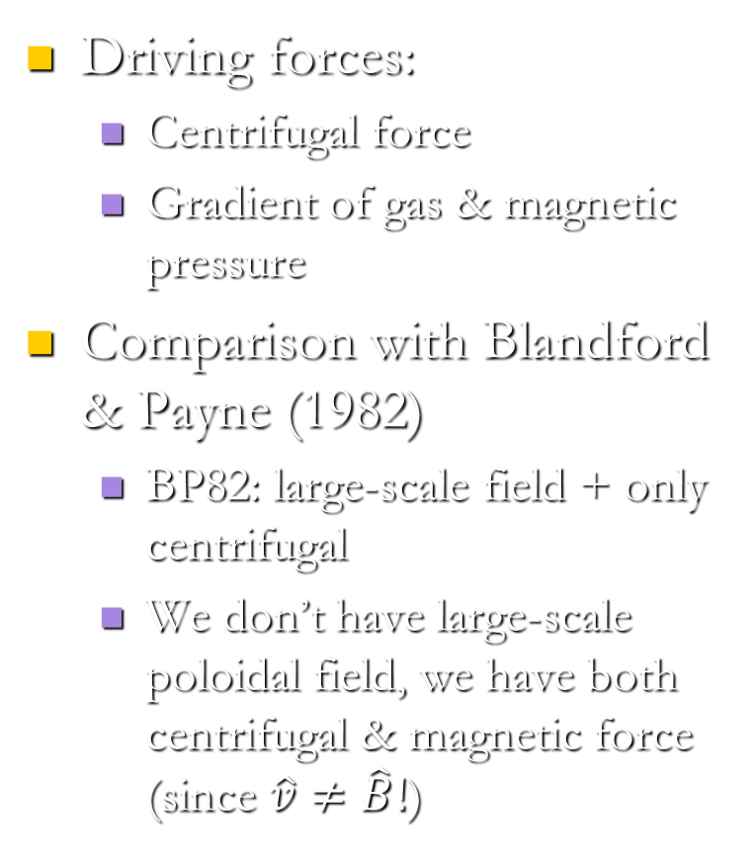
Mechanism of outflow production
Yuan et al. 2015
Driving forces:
Centrifugal force
Gradient of gas & magnetic pressure
Comparison with Blandford & Payne (1982)
BP82: large-scale field + only centrifugal
We don’t have large-scale poloidal field, we have both centrifugal & magnetic force (since $\hat{v}≠\hat{B}!$)

Slide 28
Wind vs. jet: summary
Mass flux: wind >> jet
Velocity: wind < jet
Energy flux: wind < jet only for MAD & a=0.9
Momentum flux: jet at most comparable to wind
Given that the opening angle of wind is much larger than jet,
Wind is likely much more important than jet in AGN feedback

Slide 29
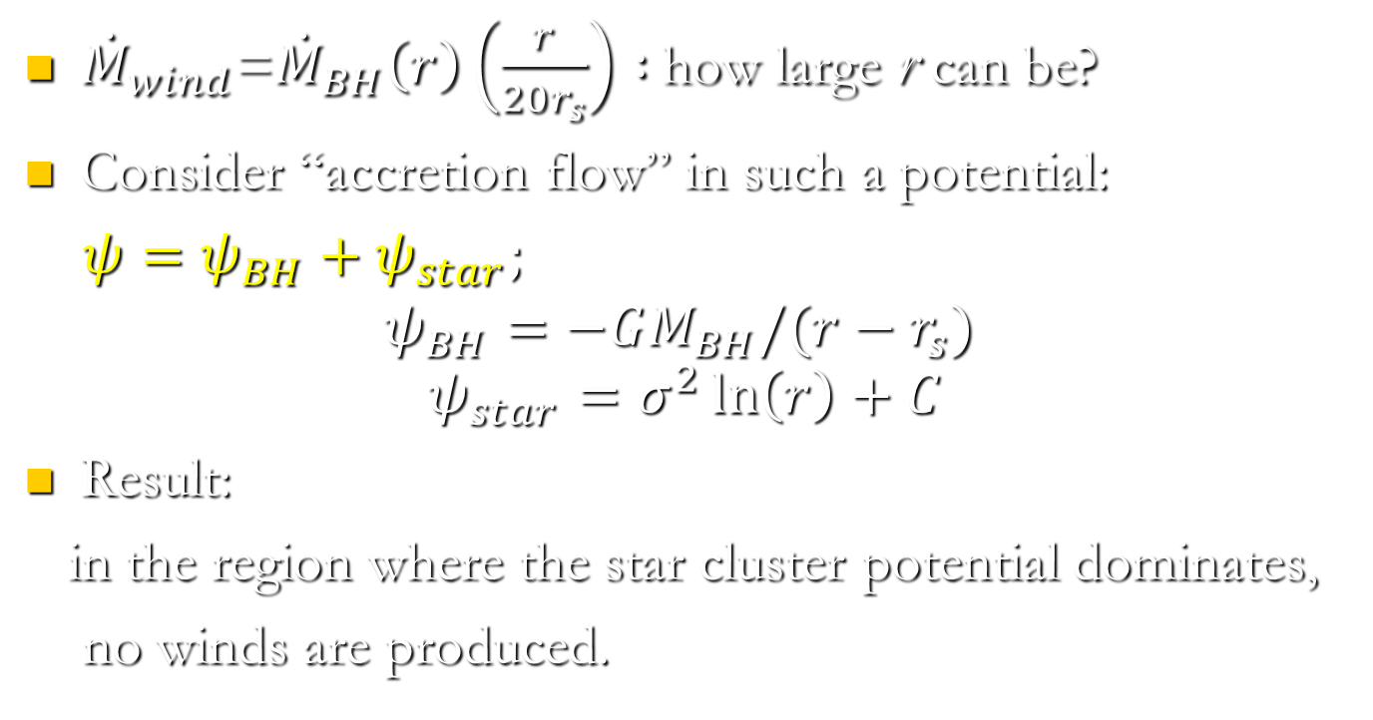
Whether or where does the wind stop to be produced?
Bu, Yuan et al. 2016
${\dot{M}}_{wind}$=${\dot{M}}_{BH}\left(r\right)\left(\frac{r}{20r_{s}}\right) :$how large r can be?
Consider “accretion flow” in such a potential:
$ψ=ψ_{BH}+ψ_{star};$
$$ψ_{BH}=−GM_{BH}/(r−r_{s})$$
$$ψ_{star}=σ^{2}\ln\left(r\right)+C$$
Result:
in the region where the star cluster potential dominates,
no winds are produced.

Slide 30
2D MHD analytical solution with winds
Mosallanezhad, Bu & Yuan 2016
Including B field
2D MHD solution
Simplification & approximation
Reproducing the main simulation results

Slide 31
Ongoing work: Does the MHD wind exist in a thin disk?

Slide 32
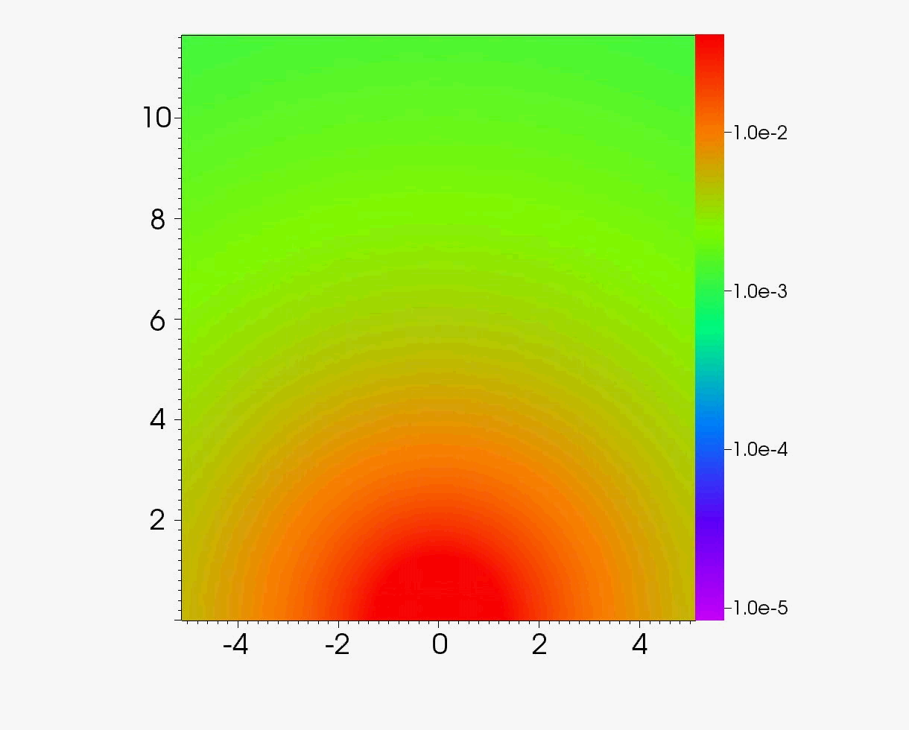
Application: “accretion wind” model for Fermi bubbles
Mo, Yuan et al. 2014; 2015
Su et al. 2010; Ackermann et al. 2014
The wind model:
* Scenario: int. between wind & ISM
* Simul.: 3D + Two-fluid + MHD
Implication:
Cavities in galaxy clusters

Slide 33
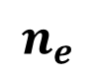
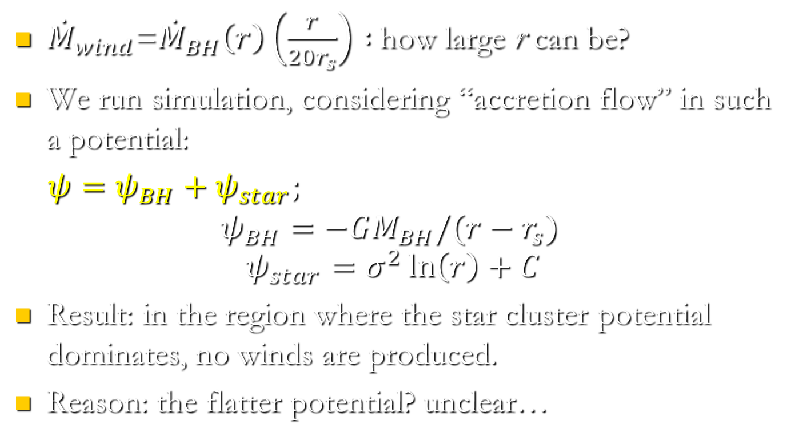
Results (II): γ-ray radiation
Mou et al. 2015
$$n_{e}$$
$$e_{2}$$
Permeated
Layer
Left: density and velocity. Right: CR energy density and magnetic field.

Slide 34
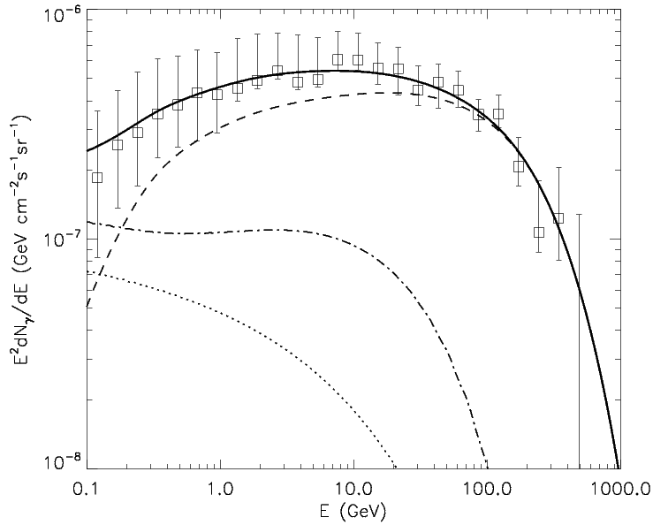
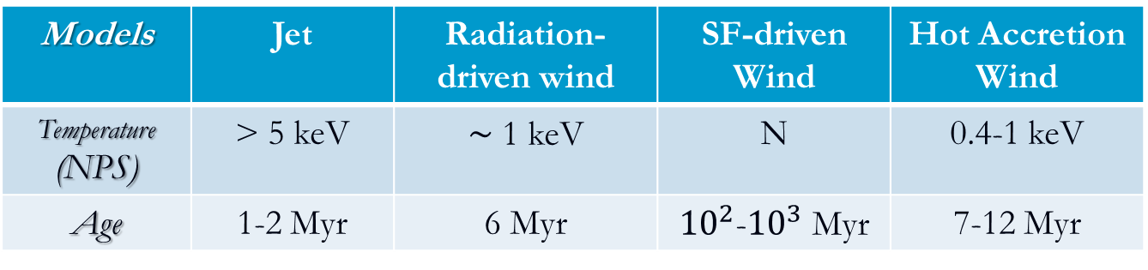
Results: γ-ray radiation and others
Total γ-rays:
Other features:
Surface brightness
Temperature of shocked
ISM (observed: 0.3 kev):
Velocity of bubble edge --- consistent with observations
18%
7%
Models | Jet | Radiation-driven wind | SF-driven Wind | Hot Accretion Wind
Temperature (NPS) | > 5 keV | ~ 1 keV | N | 0.4-1 keV
Age | 1-2 Myr | 6 Myr | ${10}^{2}$-${10}^{3}$ Myr | 7-12 Myr

Slide 35
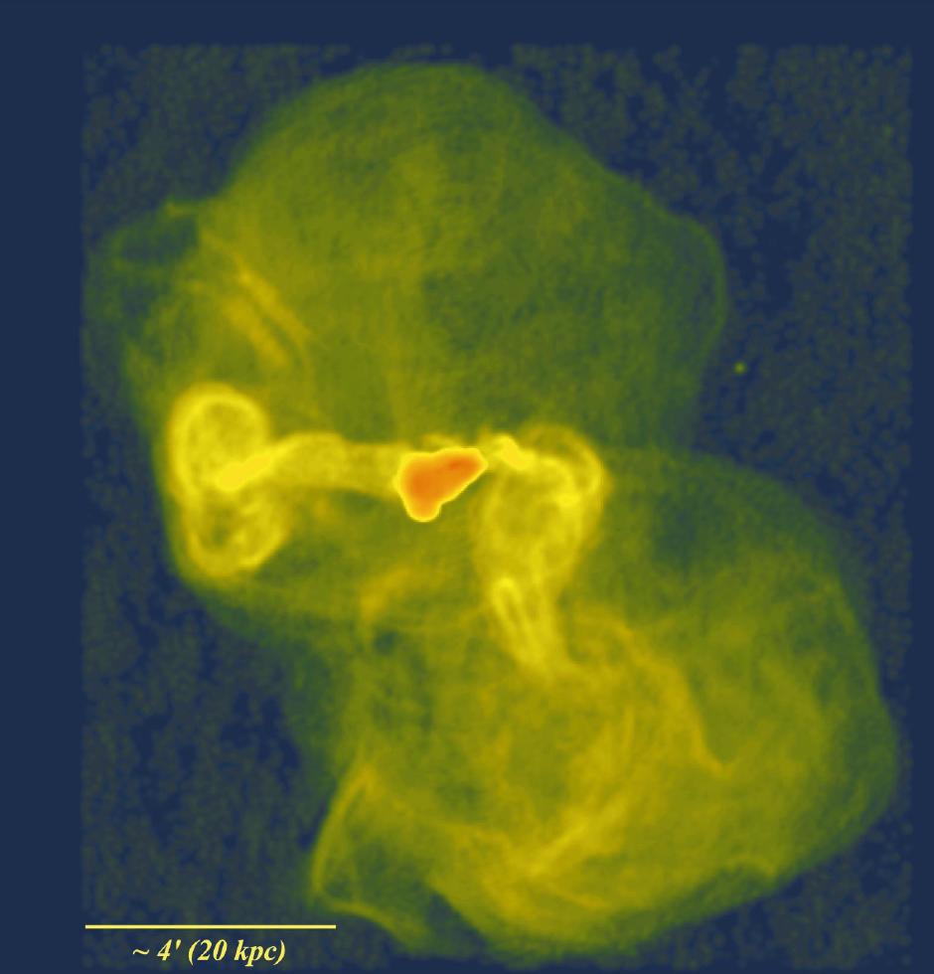
Implication: roles of wind in other aspects
Formation of X-ray cavities and bubbles by wind?
Solving the cooling flow problem?
Perseus cluster core
M87
20 kpc
M~1.2 (Graham+ 2008)
jet
Two Bubbles
Owen et al. 2000

Slide 36
Topic 2: Slim disks

Slide 37
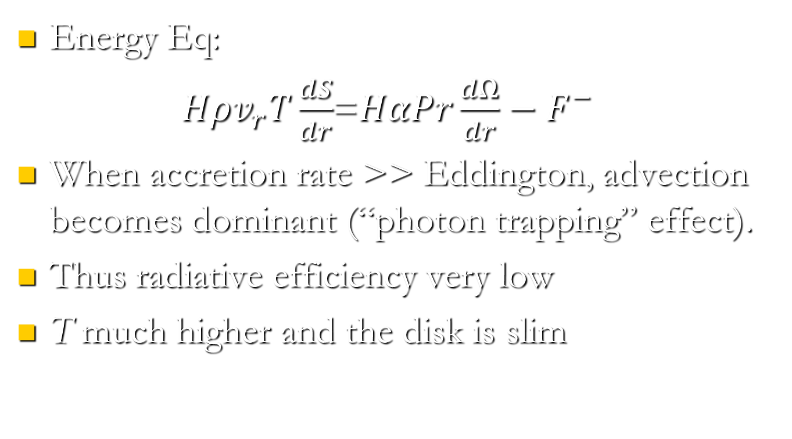
One-dimensional model: energy advection
Energy Eq:
$Hρv_{r}T\frac{dS}{dr}$=${HαPr\frac{dΩ}{dr}−F}^{−}$
When accretion rate >> Eddington, advection becomes dominant (“photon trapping” effect).
Thus radiative efficiency very low
T much higher and the disk is slim

Slide 38

Photon Trapping: 1D scenario
Radiation
Radiation
Accretion Flow
BH
$t_{diff}\sim \frac{τH}{c}$; $t_{acc}\sim \frac{r}{v_{r}}$
So photon-trapping occur in the super-Eddington flow

Slide 39
Recent works
Analytical works
1D: Gu & Lu 2007; Gu et al. 2009; Gu 2012; Cao & Gu 2015
2D: Jiao & Wu 2011;
RHD & RMHD numerical simulations
Ohsuga et al. 2005; Ohsuga & Mineshige 2011
Yang, Yuan & Ohsuga 2014
Jiang, Stone & Davis 2014
Sadowski, Narayan et al. 2015a, 2015b…

Slide 40
Result one: Global 3D RMHD simulation by Princeton group
Jiang, Stone & Davis 2014
Model: 220L_Edd/c^2, main results:
Efficiency high: 4.5%, similar to that of a standard thin disk (~5.6%)
Outflow significant
Why so different from 1D?Physical mechanism:
vertical advection of radiation by magnetic buoyancy very efficient!
1D model assumes only diffusion

Slide 41
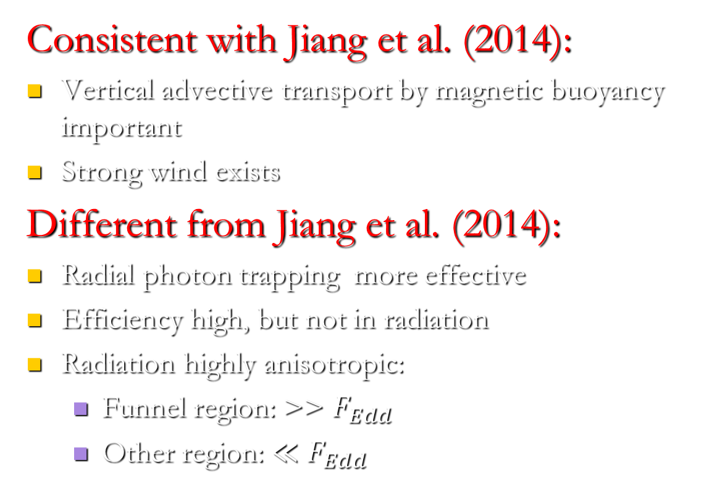
Result two: Global 2D GRRMHD result of Harvard group
Sadowski, Narayan, Tchekhovskoy et al. 2015
Consistent with Jiang et al. (2014):
Vertical advective transport by magnetic buoyancy important
Strong wind exists
Different from Jiang et al. (2014):
Radial photon trapping more effective
Efficiency high, but not in radiation
Radiation highly anisotropic:
Funnel region: >> $F_{Edd}$
Other region: ≪ $F_{Edd}$

Slide 42
Topic 3: Jet

Slide 43
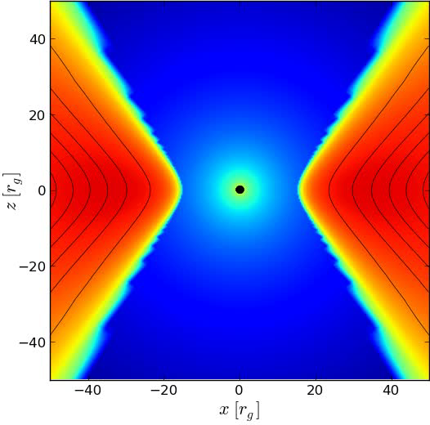
3D GRMHD Simulation: Tchekhovskoy et al. (2011) a*=0.99

Slide 44
BZ jet and disk jet
Blandford-Znajek Jet
Disk-jet
Yuan & Narayan 2014

Slide 45

BZ jet
Blandford & Znajek 1976; Tchekhovskoy 2010; Yuan & Narayan 2014
Simulations of hot flow have found BZ jets
Two key components: ordered magnetic field at the horizon and rotation of BH
Only when B can accumulate (MAD), BZ jet power is larger than disk jet
Φ: magnetic flux threading the horizon;
$Ω_{H}$=ac/2$R_{H}$: angular velocity of the horizon; $R_{H}$=Rg(1+$\sqrt{1−a^{2}}$)
κ≈0.05

Slide 46





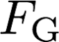





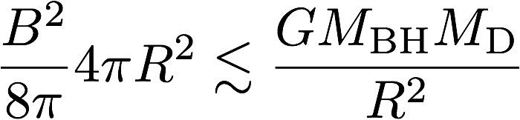
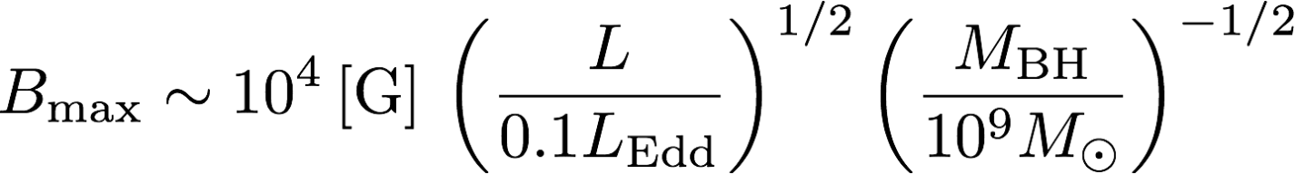
Magnetically arrested disk
Narayan et al. 2003; Igumenshchev et al. 2003
“Usually”, magnetic pressure smaller
than gas pressure
B flux can accumulate close to BH,
due to advection
Gravity limits BH B-field strength
(Narayan+ 03; Tchekhovskoy et al. 2011):
BH
Disk
R
Or:

Slide 47
MAD (continue)
when B ~ Bmax, a magnetically-arrested disk (MAD) forms
Why MAD interesting? Only in this case, BZ jet power is larger than the disk-jet power (Livio, Ogilvie & Pringle 1999)
Whether MAD can be realized in nature? Unclear, depending on, e.g., microphysics
Note BZ jet power can even exceed accretion power!

Slide 48
Disk-jet versus BZ jet
Yuan & Narayan 2014, ARA&A
Matter dominated
Powered by the rotation of disk → so present even a=0 (Yuan et al. 2015)
Typically < 0.1$\dot{M}c^{2}$
For non-MAD, power of disk jet > power of BZ jet, even though BH spin is large!
not powered by Blandford-Payne, but by the magnetic tower mechanism (gradient of the pressure of toroidal magnetic field)
Disk jet may be more relevant to observation than BZ jet??

Slide 49
BZ jet: Confronting observations
Gamma Ray Burst
Long GRB: required B flux too large, thus the star unlikely rapidly rotating to power GRB
Short GRB: required B flux too large for a old neutron star
Tidal disruption event
Disrupted star unable to supply the B field to power the jet
AGNs: (indirect) supporting evidence in Blazar

Slide 50
Observation (I): Correlation between jet power & BH spin
Narayan & McClintock 2012
Fender, Gallo & Russell 2010
The main reason for the discrepancy: the estimation of jet power!

Slide 51
Observation (II): jet in a BH candidate (4U1630-47)
Diaz Trigo et al. 2013, Nature
Jet velocity: 0.66c; opening angle: 4 degree
X-ray emission lines from the jet detected
Baryons exist in jets!
Not powered by BH spin, but by the disk
→disk jet or episodic jet!

Slide 52
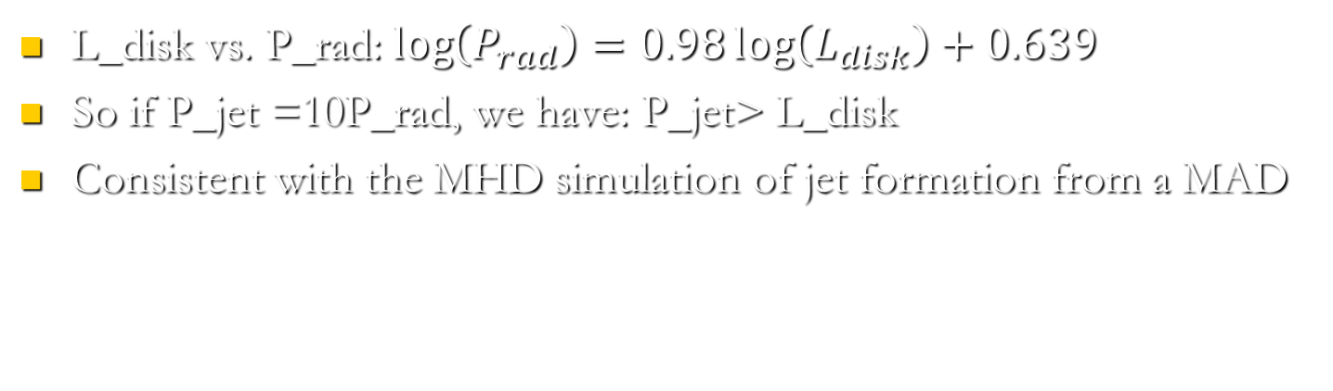
Observation (III): correlation between jet power and disk luminosity
Zamaninasab et al. 2013, Nature; Ghisellini et al. 2014, Nature
L_disk vs. P_rad:$\log\left(P_{rad}\right)=0.98\log\left(L_{disk}\right)+0.639$
So if P_jet =10P_rad, we have: P_jet> L_disk
Consistent with the MHD simulation of jet formation from a MAD

Slide 53
Summary
Numerical simulation is a powerful tool to study black hole accretion
Accretion: strong outflow exists
Super-Eddington accretion:
different from the analytical model
BZ jet: confirms the original analytical model
Disk-Jet vs BZ jet: unclear which one is realistic

Slide 54
END

